Slide 1
News Article Topic Prediction
Emma Gillen,
Prasad Duvvuri,
Tiffannie Mac Donald

Slide 2
Introduction

Slide 3
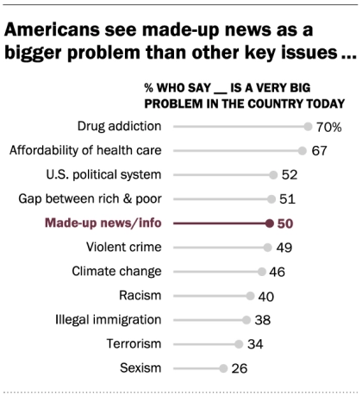
Do we trust the news?
Survey conducted by the Pew Research Center in Spring 2019
50% of Americans say made-up news or information is a very big problem in the United States
63% of Americans have stopped getting their news from a particular outlet
43% have lessened their overall news intake
Notes:
https://www.journalism.org/2019/06/05/many-americans-say-made-up-news-is-a-critical-problem-that-needs-to-be-fixed/
Bias is often unavoidable, a fact increasingly obvious in news reporting and journalism. According to a survey conducted by the Pew Research Center in Spring 2019, 50% of Americans say made-up news or information is a very big problem in the United States. This ranks higher than issues like violent crime and climate change.
However, it is unclear how to mitigate this problem. According to the same survey, 63% of Americans have stopped getting their news from a particular outlet and 43% have lessened their overall news intake. While this may lower the amount of false information consumed, total avoidance of world issues is undesirable.

Slide 4
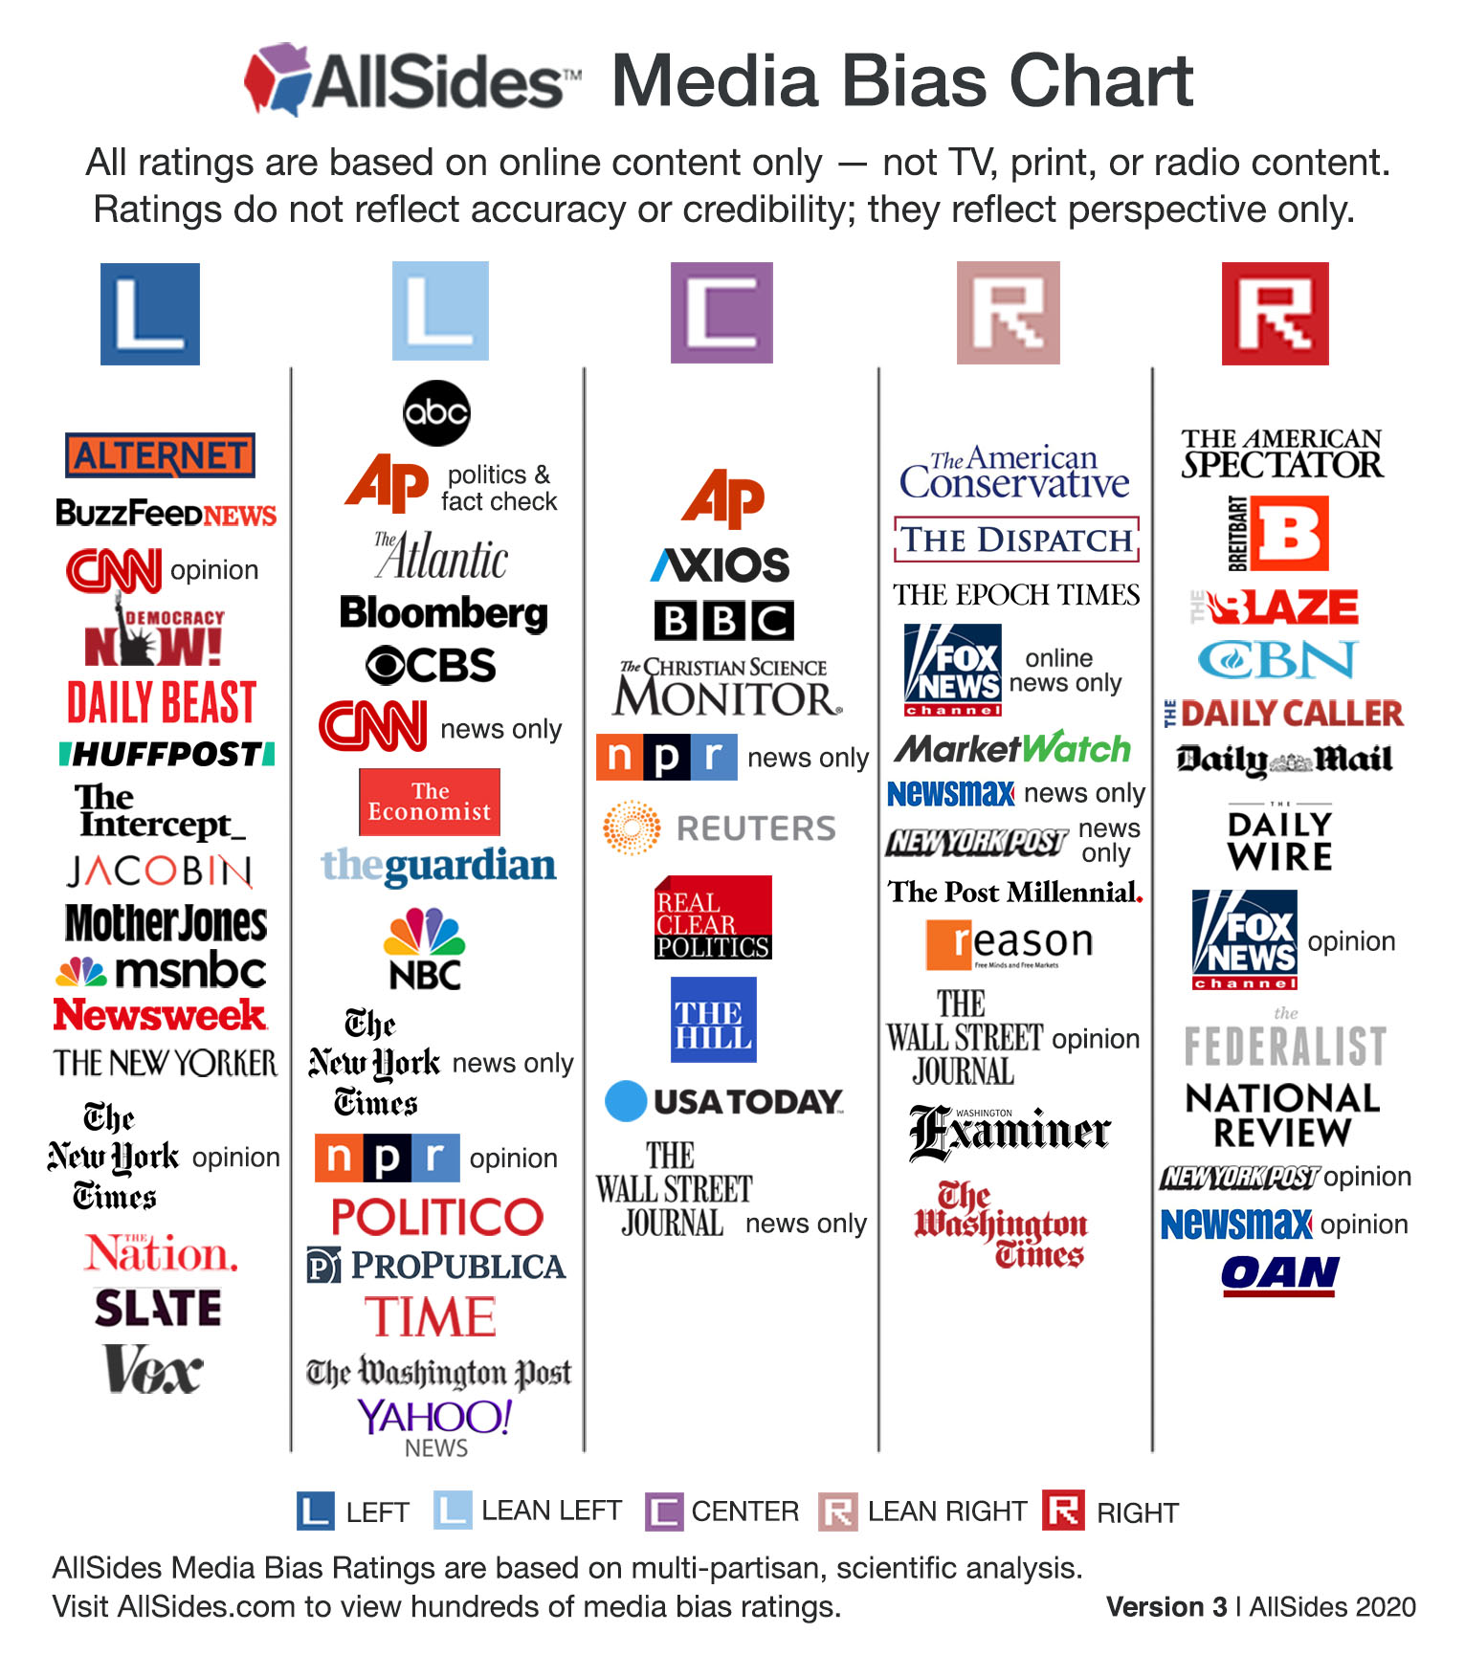
How can we mitigate this?
Gather news from various different sources, with varying perspective
Build a model on labeled data to categorize news articles by topic
Use models/labels to get a “big picture” idea of what is going on in each topic
Notes:
https://www.allsides.com/media-bias/media-bias-chart
A possible solution is to consume media from multiple news sources, with various political affiliations. By reading reporting from different sources, the mutually reported information will likely be closer to fact. However, the task of consuming multiple times the standard amount of media is infeasible for the average person. Instead, the hope is to produce a programmatic procedure to gather news topics, devoid of bias.

Slide 5
Data Collection and Processing

Slide 6









Data Collection
Topics:
Medical
Politics
Business
Sports
Entertainment
Specialized
Sources

Slide 7
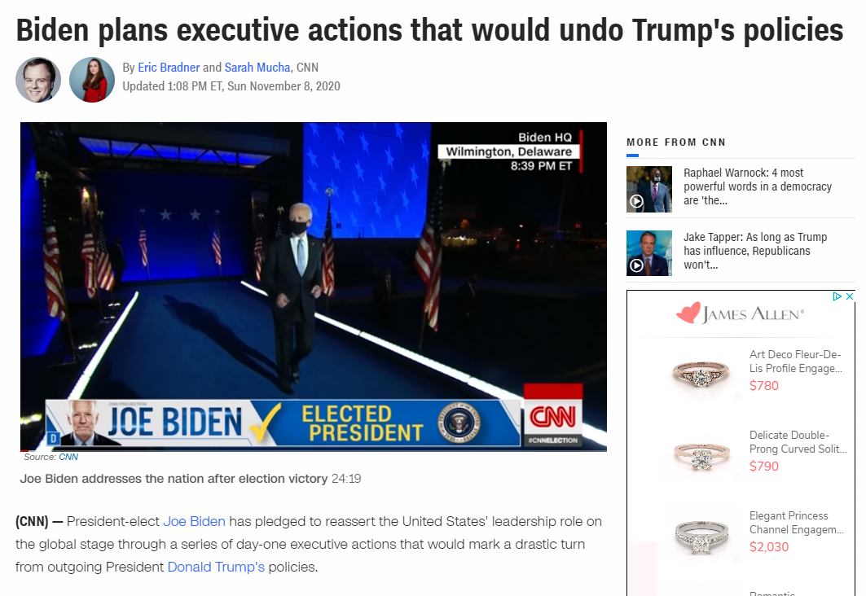
Title
Author(s)
Article Text

Slide 8
Corpus Preparation
Tokenization
Using Regular Expressions
Vectorization
TF-IDF
Binary
Stemming and Lemmatization
Gensim Lemmatizer
Porter Stemmer
Four combinations
Notes:
nouns, verbs, adjectives, and adverbs

Slide 9
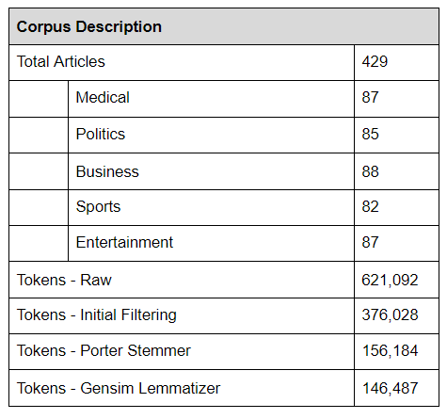

Slide 10
Data Exploration and Analysis
Notes:
Be sure to disclose that these findings are technical

Slide 11
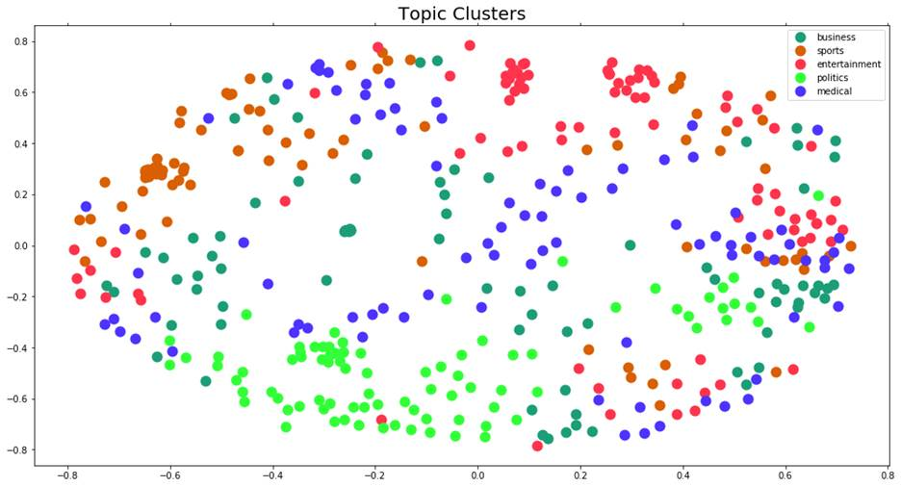
Clustering - Labeled

Slide 12
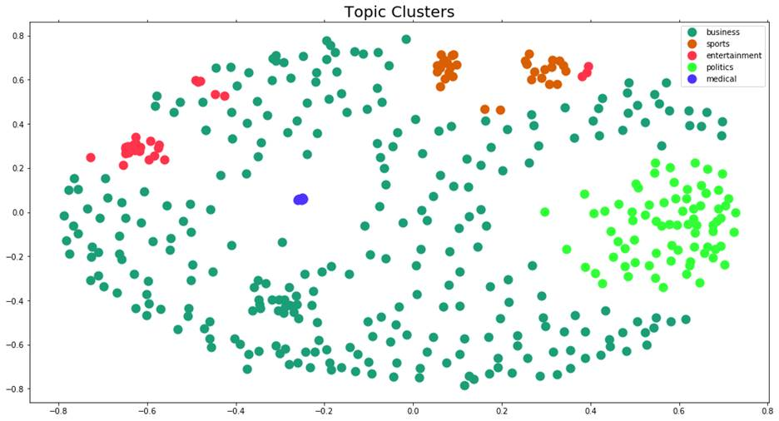
K-Means Clustering - Unlabeled

Slide 13
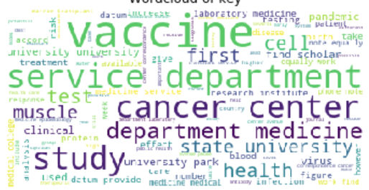
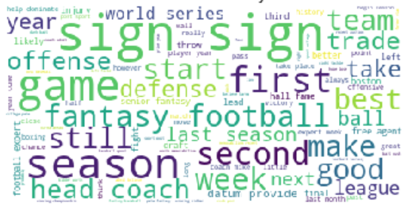
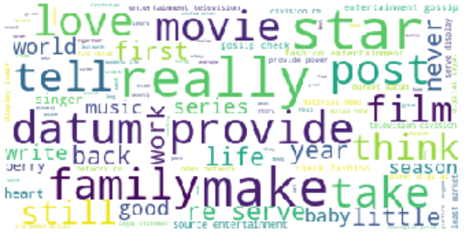
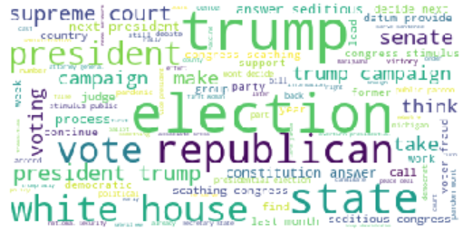
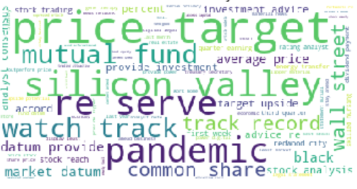
Topic Word Clouds

Slide 14
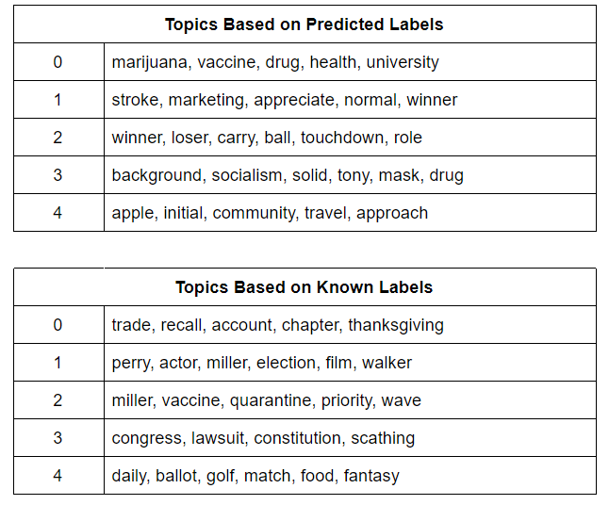
Topic Modeling- Predicted vs. Actual
Predicted- topics found using Gensim library
Actual- the topics assigned to the cluster upon reading in the data

Slide 15
Supervised Models

Slide 16
Models Explored
Multinomial Naive Bayes (MNB)
Bernoulli Naive Bayes (BNB)
k-Nearest Neighbors (kNN)
Support Vector Machine (SVM)
Linear
Polynomial
Radial Basis Function (RBF)
Decision Tree
Random Forest

Slide 17
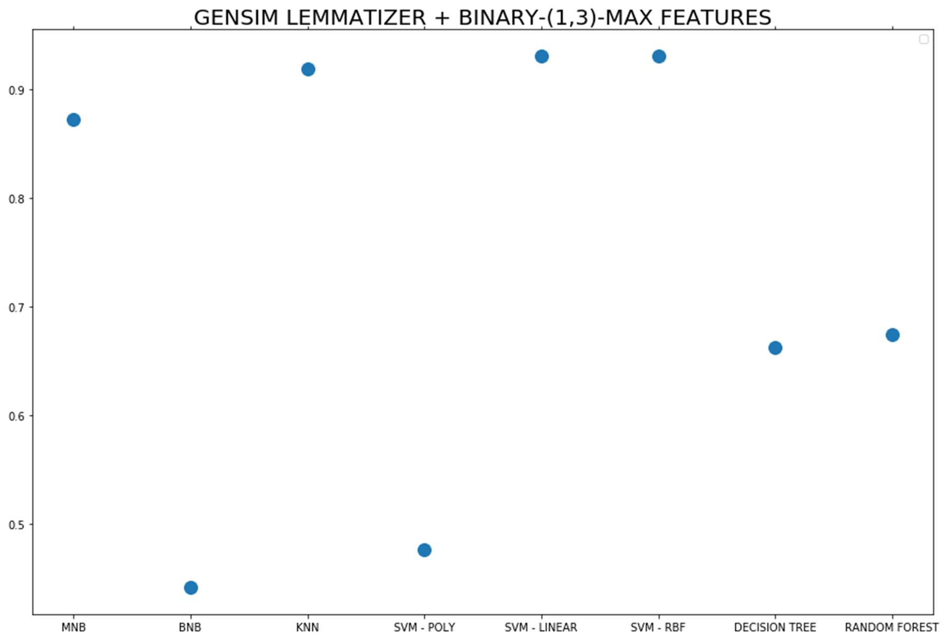

Slide 18
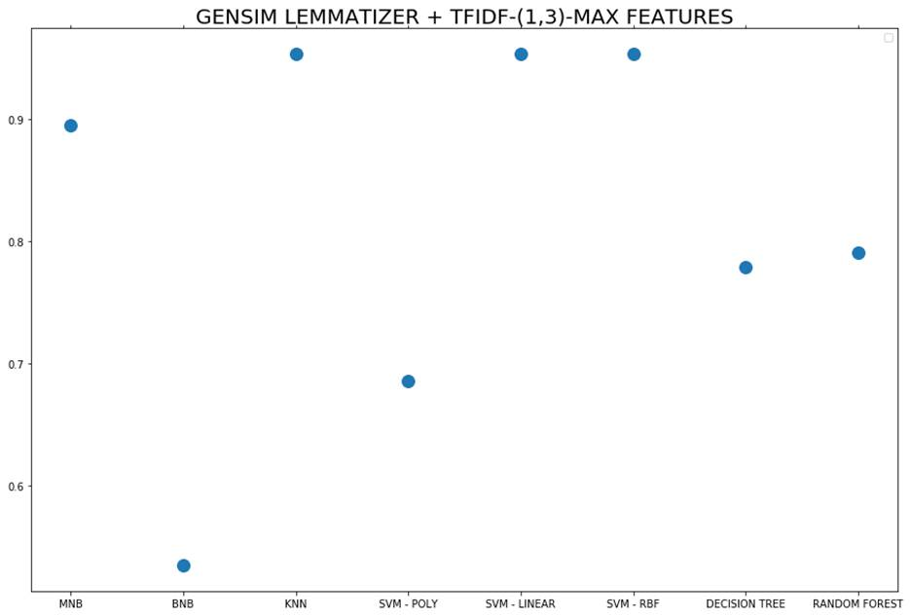

Slide 19
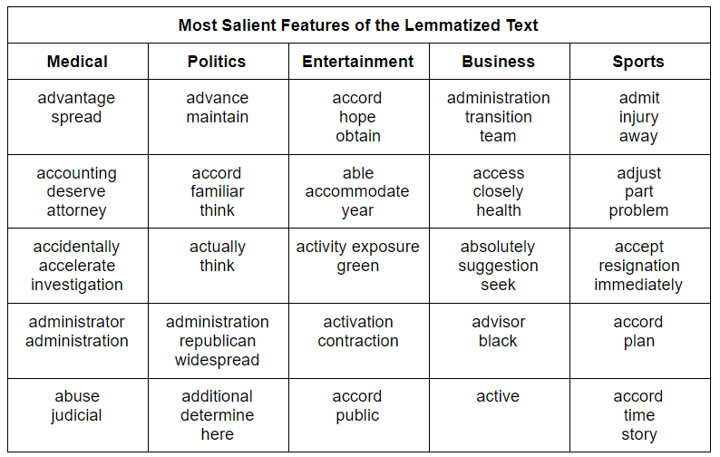

Slide 20
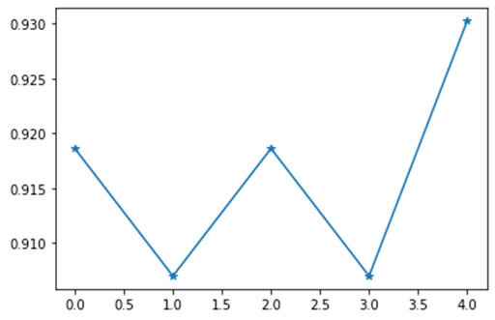
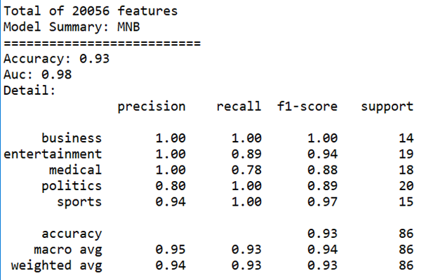
Multinomial Naive Bayes - Top Features

Slide 21
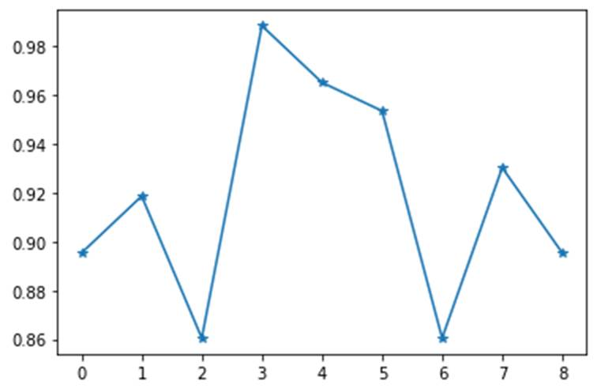
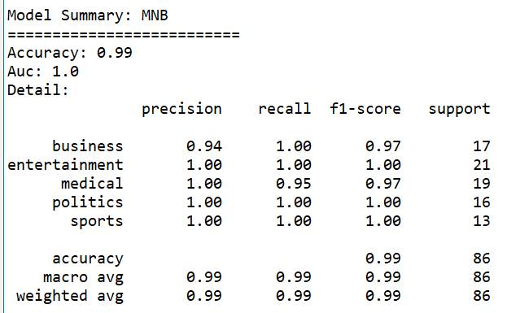
Feature Selection Based on P-Value

Slide 22
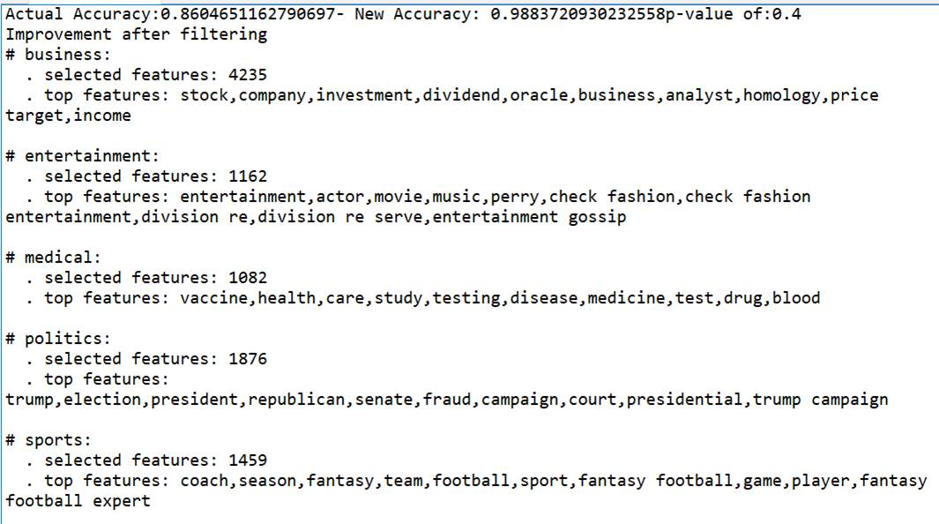
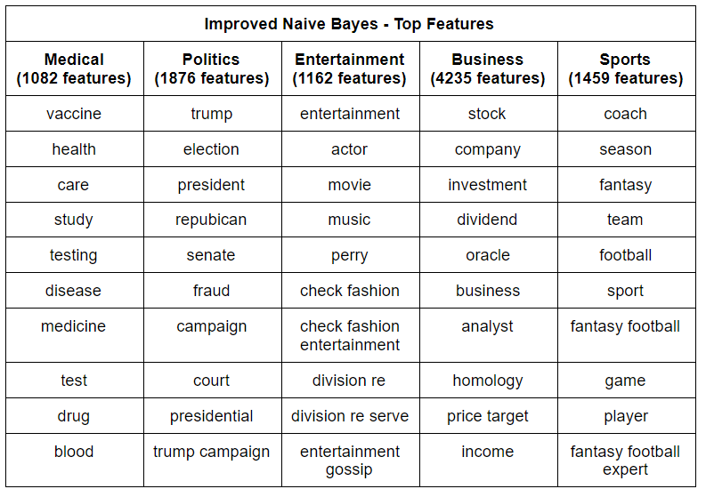

Slide 23
Summary & Conclusion
Multinomial Naive Bayes is best suited for this task
Speed
Feature ranks
Gensim Lemmatizer
Tf-idf vectorization
Accuracy above 90% at classifying unseen documents
Can categorize news articles
Feature ranking shows us what topics to expect
Word clouds and topic modeling can be used to understand high level ideas

Slide 24
Questions

